Slide 1
eXo Fundamentals Training
Portal Elements and Organization Model
Notes:
1

Slide 2
Portal
2
Notes:
2

Slide 3
Portal
Per site, per group, per user, you have the fallowing components:
Set of pages
Set of navigations
Common layout
Effect: Different layout and different navigations for site pages, group pages and user pages.
Notes:
3

Slide 4
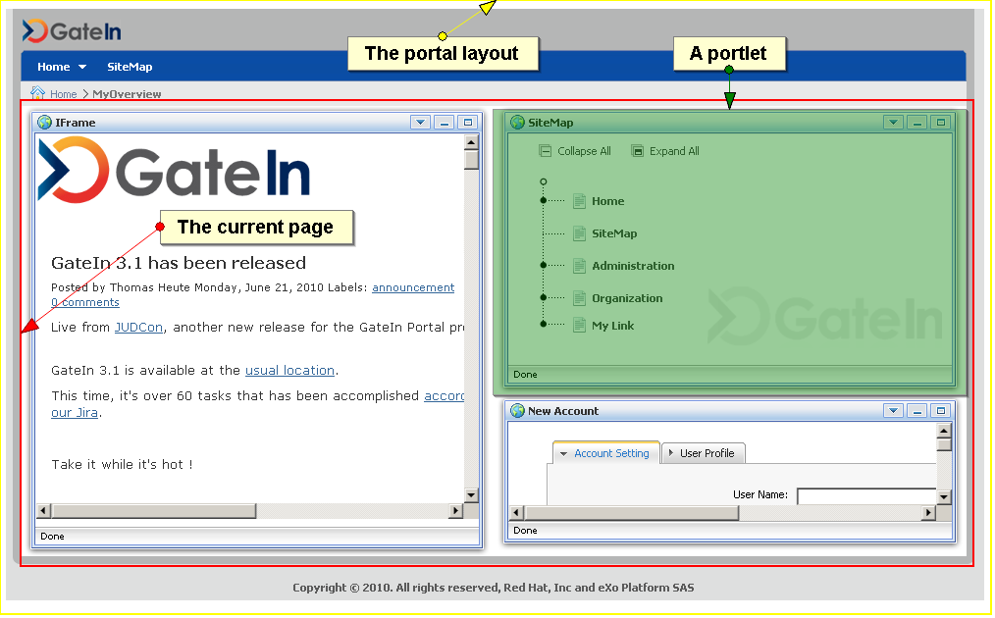
Portal
Portal : manages the aggregation and personalization of the portlets.
Many portals can run on the same eXo Platform server. Each of them has a different URL.
Each portal contains a number of pages.
Each page contains one or several portlets.
Notes:
4

Slide 5
Portal
Notes:
5

Slide 6
Portal
Portlet arrangement
Portlet4
Portlet1
Portlet2
Portlet3
Notes:
6

Slide 7
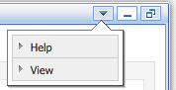
Portlets
Portlet : A rectangular bloc which allows to access to a content or a service.
Each portlet has some preferences, settings and decorations.
The portlet can be positioned in any place of a page.
You can reuse the same portlet several times: Then we say there are several instances of the same portlet.
Each instance of the same portlet can be configured differently.
Window decoration (optional)
Window states: maximized, minimized
Portlet Modes: view, edit, help
The combination of a portlet instance + preferences + decorations is also called an “application”.
Notes:
7

Slide 8
Page
Contains a set of applications.
Defines the layout of these applications.
There a many pages on a portal.
Permission Settings
Access permission
Edit permission
3 page types : site, group and user dashboard
Notes:
8

Slide 9
Manage Sites
9
Notes:
9

Slide 10
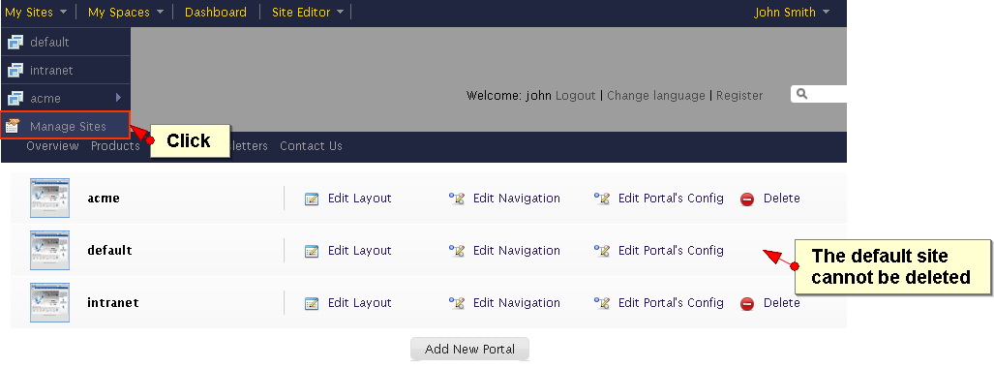
Manage your Sites
You can manage several sites.
Sometimes the terms “site” and “portal” are interchanged.
Each site has it’s own layout, navigation, pages and properties.
Notes:
10

Slide 11
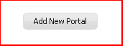
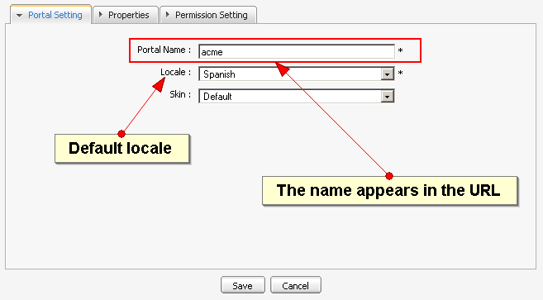
Manage your Sites
Click on “Add New Portal” and choose a name, locale and skin for your site.
Notes:
11

Slide 12
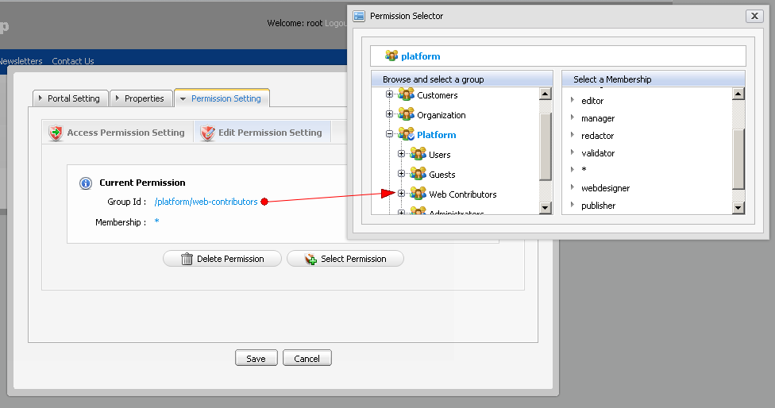
Site Permissions
Distinction of access and edit Permissions
Notes:
12

Slide 13
Exercise: New Site (15 min)
Create a new Site and manage its permissions
Login as John.
Click on Manage Sites in the Admin Tool Bar and add a new site (portal) called “bike”.
Allow access to everyone. Gives edit rights anybody in the group “platform/users”. (platform/Visitors)
Save.
Careful, by misadventure you might exclude yourself from your new site: For example, give the edit rights to “platform/bike” only. If you are not part of this group you will not see the new site in the “Manage Sites” interface anymore – in order to see the site again you have to add your user to the group.
Notes:
13

Slide 14
Layout
14
Notes:
14

Slide 15
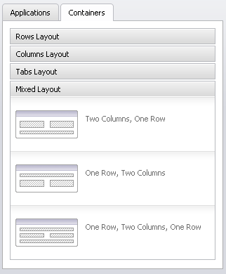
Containers
Containers help to position elements on the page.
They are invisible.
You can use them in :
Page layout
Portal layout
You can combine different containers.
Notes:
15

Slide 16
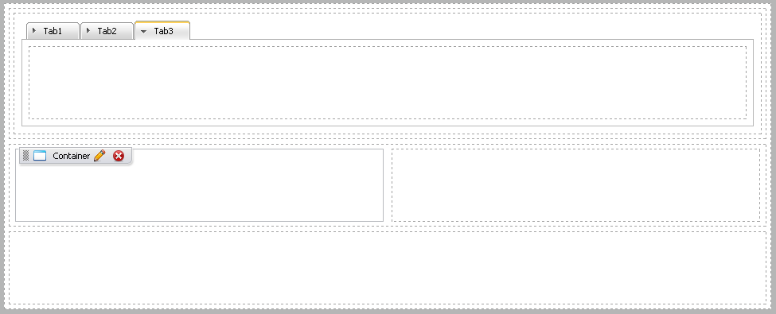
Containers
Container combination
Notes:
16

Slide 17
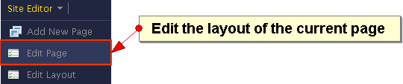
Page Layout
Defines the layout of the current page.
You see the position of the applications in the page and a page editor.
The page editor shows an applications and a containers tab. Clicking on these tabs switches also the between an application and a container mode.
Drag and drop an application from the page editor to the page: In that moment you create a new instance of the portlet.
Drag and drop applications inside a page.
Notes:
17

Slide 18
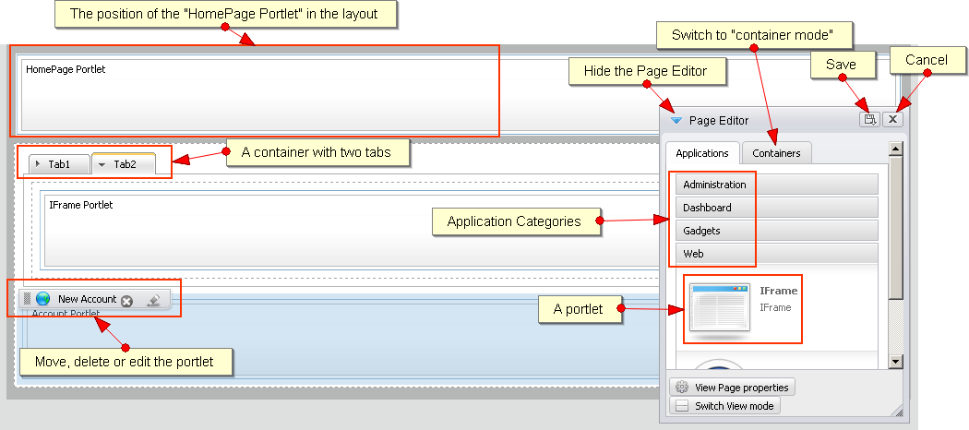
Page Layout
Notes:
18

Slide 19
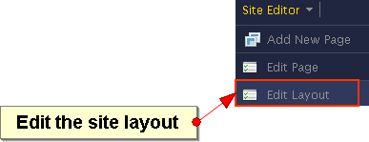
Portal Layout
Defines the base layout of all pages of the portal (site portal, group portal or personal pages).
Works the same way as the page layout.
A special place holder called “Portal Page” indicates the position of the pages in the portal.
Modify the portal layout by clicking on “Edit Layout”.
Notes:
19

Slide 20
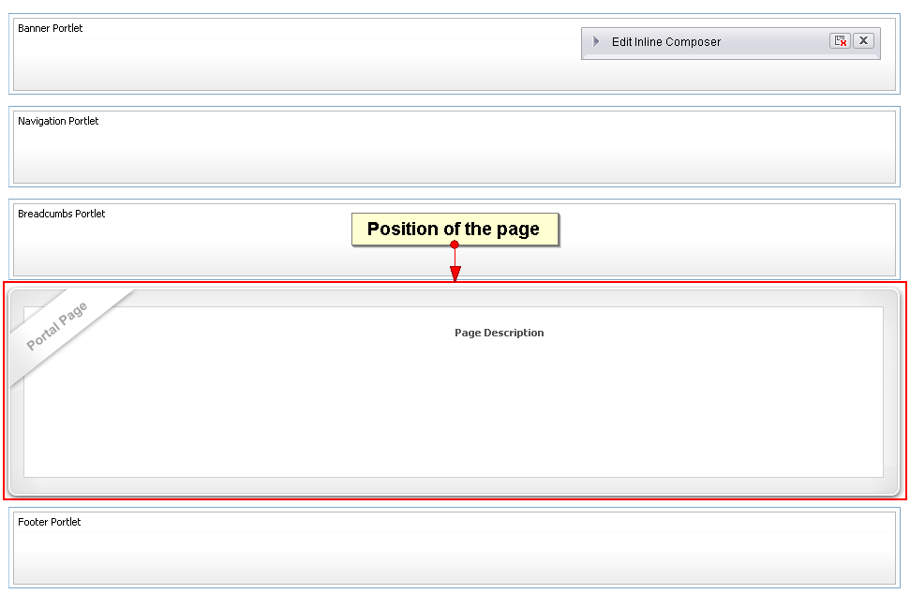
Portal Layout
Notes:
20

Slide 21
Exercise 1/2: Layout (20 min)
Page Layout
Login as John. Go to the home page of the bike site.
Click on “Add new page” and browse to the root of the navigation (green arrow).
Call the new bike “Bike Shop”.
Add at least one application to the page (otherwise it won’t show up). Save.
Go to the home page of the bike site. Click on Edit Page.
Drag a three tabbed container in the layout.
Drag some applications in the container tabs.
Save.
Switch between your pages “Bike Shop” and the home page.
Notes:
21

Slide 22
Exercise 2/2: Layout
Portal Layout
Click on the bike homepage, then on “Edit Layout”, modify the layout of the portal. Save.
Switch between the homepage and “Bike Shop” page in order to see the differences.
Notes:
22

Slide 23
Navigation
23
Notes:
23

Slide 24
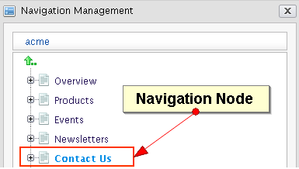
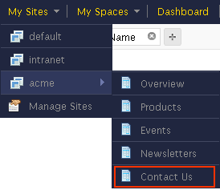
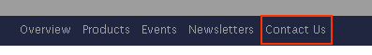
Navigation
Manage access to portal pages
Hierarchy structure of navigation nodes
Each node references a page
Aggregation types: site, group, user
Navigation portlet: Represents the navigation in a menu
Notes:
24

Slide 25
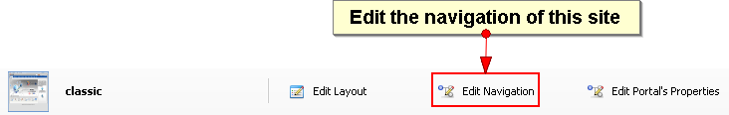
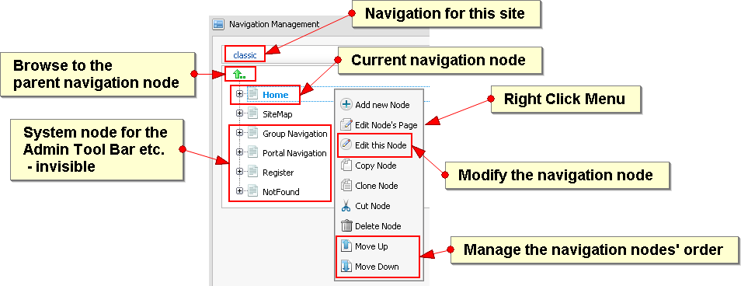
Navigation
Notes:
25

Slide 26
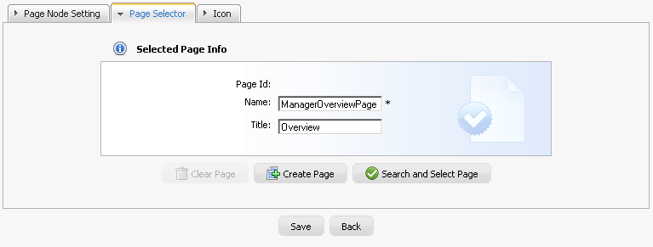
Navigation
Each navigation node is assigned to a page.
You create a new page or select an existing one.
You can point to same page from different navigation nodes.
Notes:
26

Slide 27
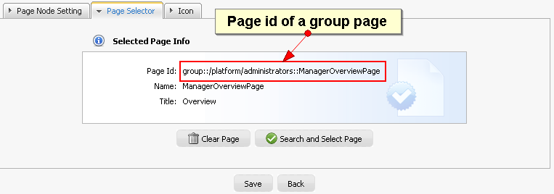
Navigation
Each page has a page name (internal) and a title (for interfaces).
The page is created automatically.
Notes:
27

Slide 28
Portal Summary
Navigation is node based.
A page can be referenced by many nodes.
A portal is a set of pages and navigations.
A page is a set of containers.
A container can contain applications and other containers.
Notes:
28

Slide 29
Exercise 1/2: Site Navigation (15 min)
Create a new page, find it in the navigation and create new navigation
New Site Page
Login as John.
Open a site page.
Click on “Add new page” and browse to the root of the navigation (green arrow).
Add at least one application to the page (otherwise it won’t show up). Save.
Site Navigation
Click on “Site” in the Admin Tool Bar and open the navigation of your site.
Verify the existence of your new navigation node and page.
Notes:
29

Slide 30
Exercise 2/2: Site Navigation
Create a small navigation tree that reuses pages
Each page contains an IFrame portlet configured to show a target site.
Create the new pages “exoBlog” (http://blog.exoplatform.com/), “exoHome” (http://www.exoplatform.com/) and “google” (google.com).
The navigation nodes “shortcuts”, “blog” and “eXo” nodes shall reference to the same page “exoBlog”.
Create the following user navigation:
Shortcuts
Google
eXo
Blog
eXo Home
Note that several navigation nodes can point to the same page.
Your marketing boss ask to change the navigation:
Interchange the order of the subtrees eXo and Shortcuts
Cut and paste “eXo Home” from “eXo” to “ShortCuts”.
Notes:
30

Slide 31
Spaces / Groups
31
Notes:
31

Slide 32
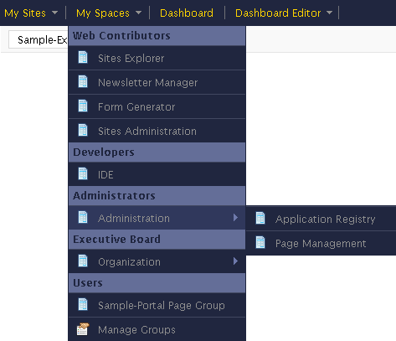
Groups
There can be a portal for each group. Portal = layout + pages + navigation
Each user belongs to one or several groups.
You see the navigations and pages of your groups in the Admin Tool Bar.
Only those users with the role “manager” can modify the navigation of a group.
Notes:
32

Slide 33
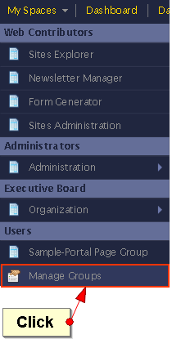
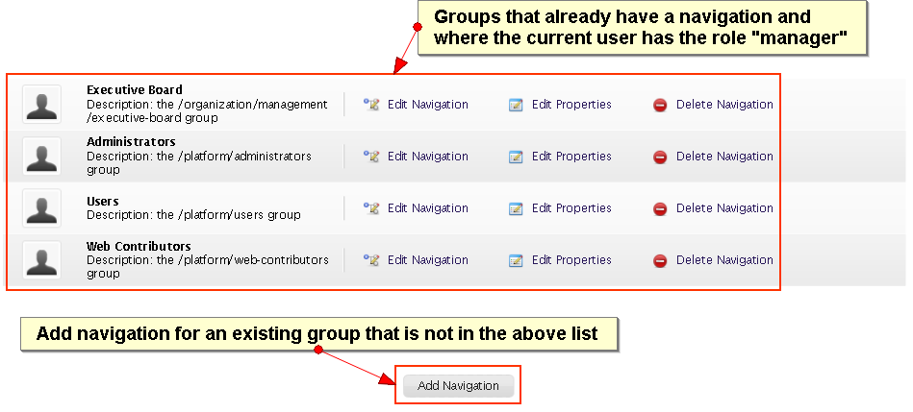
Groups
You see all groups you belong to, but only those which already have navigation.
If you are a manager, you can add new navigations for the other groups.
Notes:
33

Slide 34
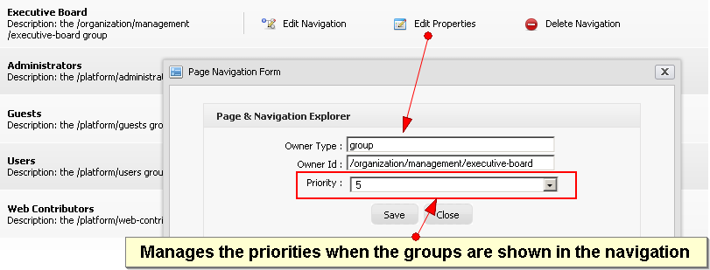
Groups
By clicking on “Edit Properties” you can define the order of the group navigations in the menu.
Notes:
34

Slide 35
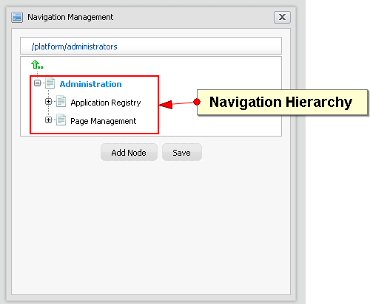
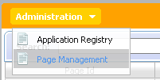
Group Navigation
Manage access to group pages
The group pages can optionally be shown in a navigation bar:
Notes:
35

Slide 36
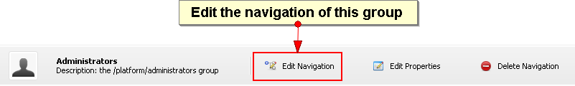
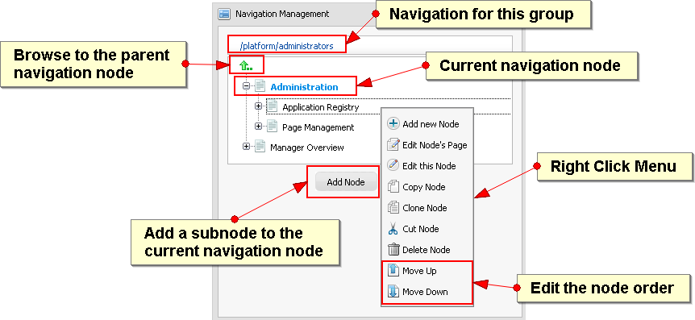
Group Navigation
Notes:
36

Slide 37
Exercise 1/2: Group Portal (15 min)
Create a new page in a group, create pages accessible for platform/bike only, modify the layout of this group’s pages.
New Group Page
Login as John. Open a group page of platform/administrators.
Click on “Add new page” and browse to the root of the group navigation (green arrow).
Add at least one application to the page (otherwise it won’t show up). Save.
Notes:
37

Slide 38
Exercise 2/2: Group Portal
Groups Navigation
Click on “Manage Groups” in the Admin Tool Bar and open the navigation of platform/administrators.
Verify the existence of your new navigation node and page.
Make john a manager of the group “platform/bike”. Add a navigation to the group platform/bike. Add two new navigation nodes to the group, select any existing page or create new pages.
Group Layout
Click on a page of “platform/administrator and modify the portal layout for all pages of this group (“Edit Layout”).
Modify also the layout of the platform/bike group portal.
Switch between the pages of the different groups in order to experience the differences.
Notes:
38

Slide 39
Application Registry
39
Notes:
39

Slide 40
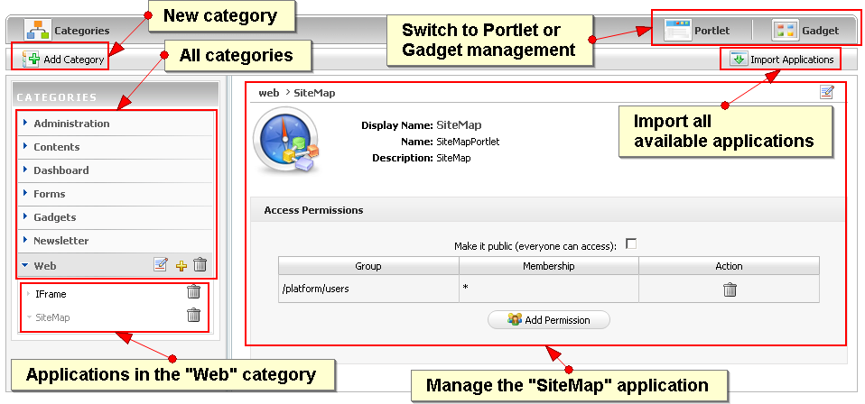
Application Registry
An application can be a portlet or a gadget.
Notes:
40

Slide 41
Application Registry
In the registry you can configure which applications are available to the users.
The available applications appear in the page and portal layout dialogs.
You can define access permission on category level and for each application.
The user only sees those applications where permissions in both levels are granted.
Notes:
41

Slide 42
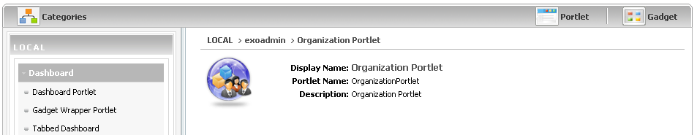
Application Registry
Portlets
Notes:
42

Slide 43
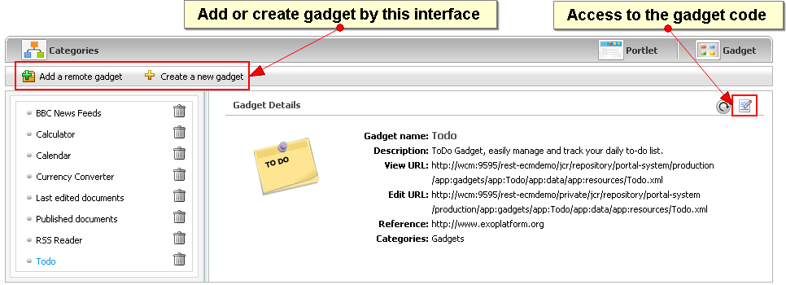
Application Registry
Gadgets
Can be loaded, created and modified.
Notes:
43

Slide 44
Exercise 1/2: Application Registry (20 min)
Import
Import all applications
Create a new application category.
Add some applications to your category.
Make your category accessible to all users.
Gadget
Switch to the Gadget panel. Add a new gadget to your category.
Modify the gadget code by replacing “hello world” by “toto”.
Layout
Create a test page, open the layout and test the new category and applications.
Notes:
44

Slide 45
Exercise 2/2: Application Registry
Permissions
Create an application category only accessible for the group “organization/management”.
Open an application in a public category and make it visible only to the management, put this application into a category available to all users.
Login as “elena”,
Click on dashboard
Add new page. Check if there are categories and application that are only accessible to the management.
Logout, login as john, put “elena” in the “organization/management” group
Click on dashboard
Add new page. Check if there are categories and application that are only accessible to the management.
Notes:
45

Slide 46
Examples
46
Notes:
46

Slide 47
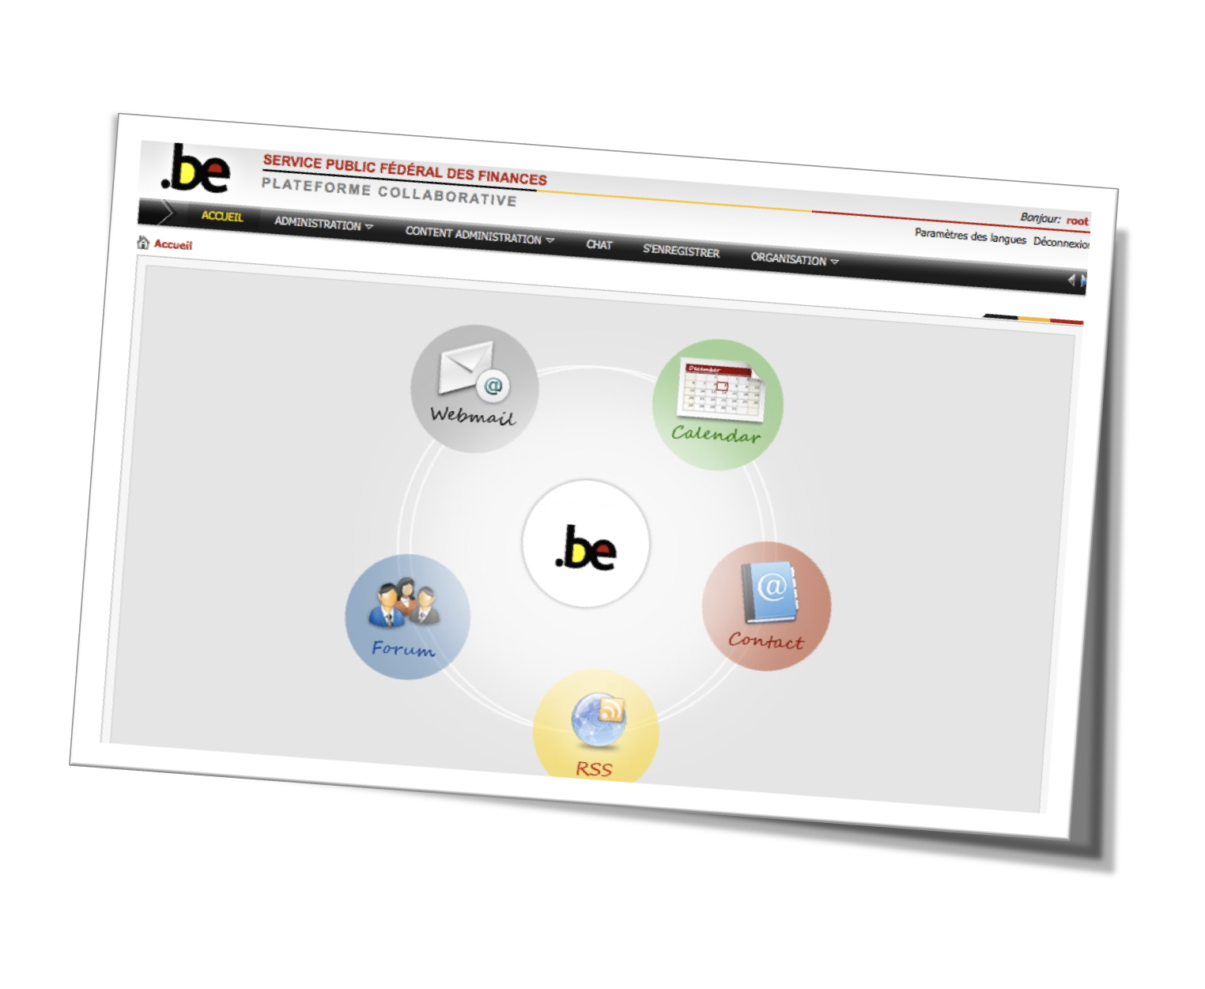

Slide 48
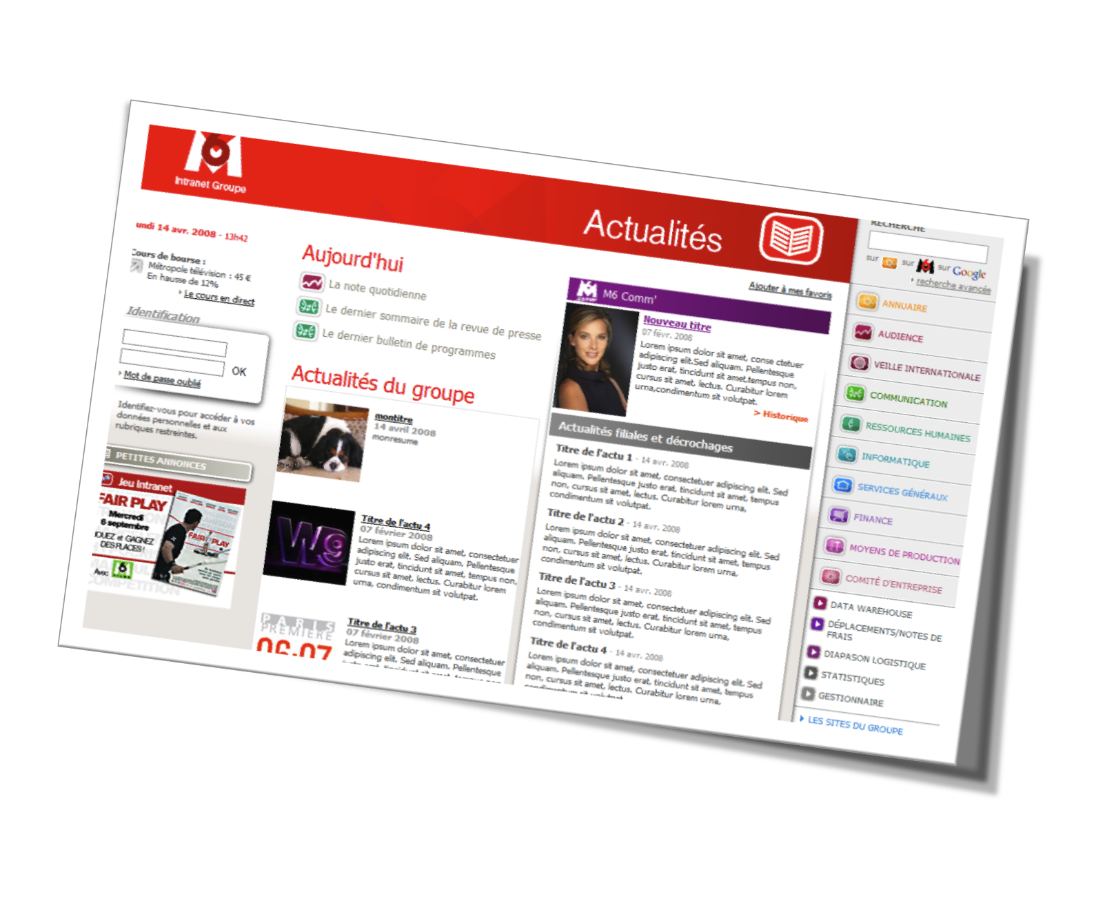

Slide 49
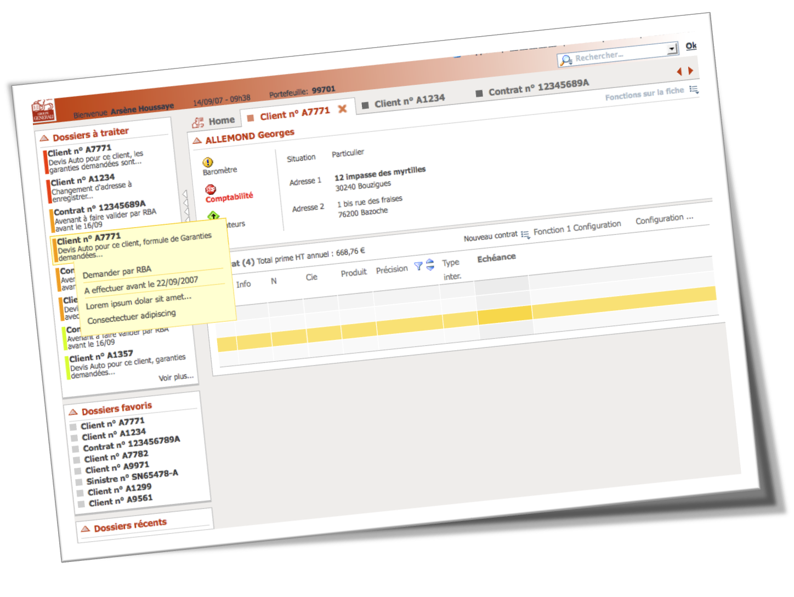

Slide 50
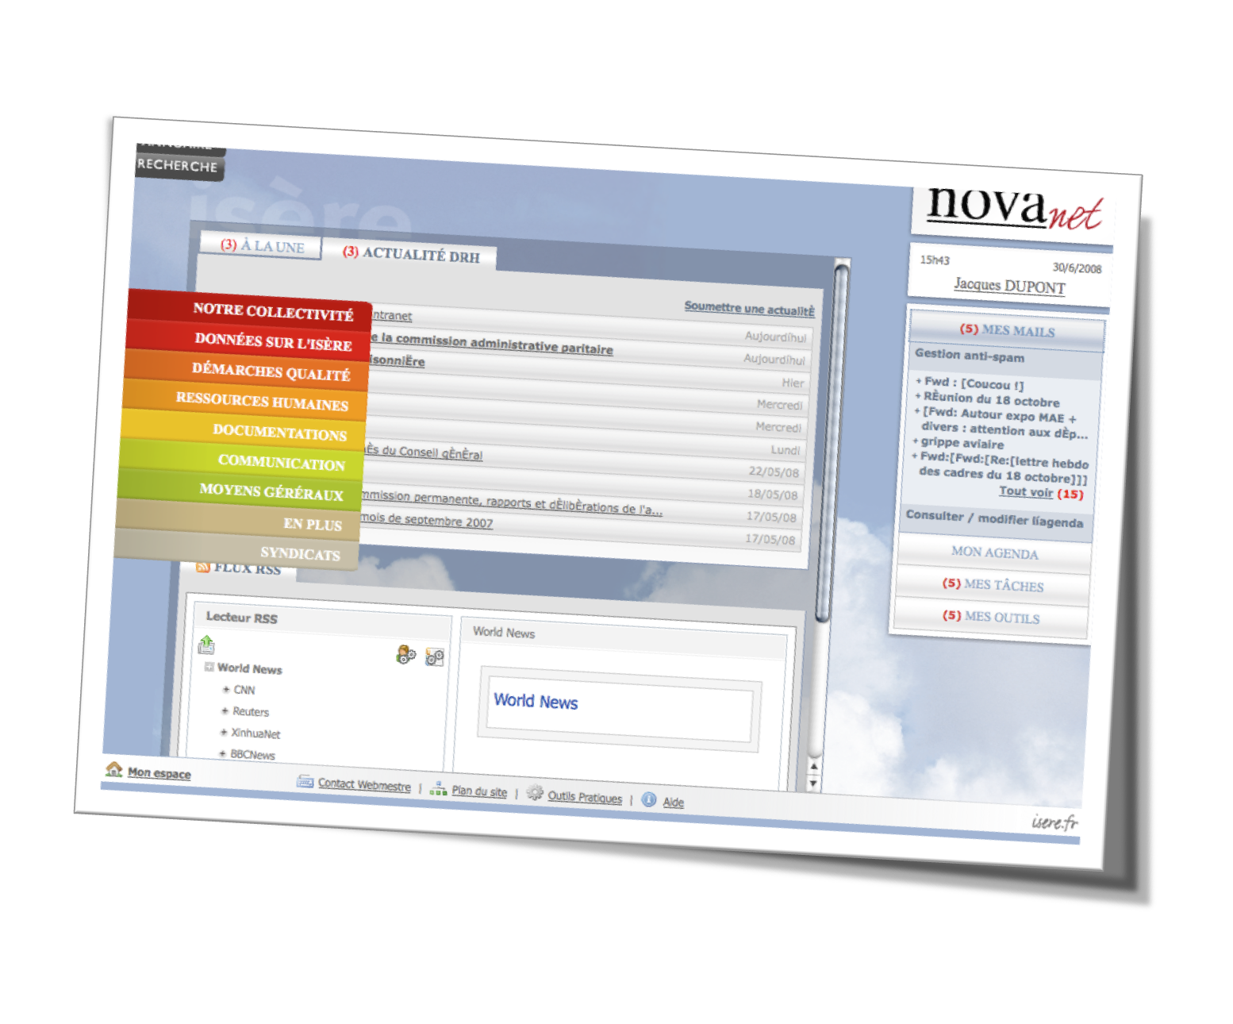

Slide 51
eXo Fundamentals Training
Portal Elements and Organization Model
Q & A
Notes:
51

